Slide 1
Professional Development
25th of Jan 2023

Slide 2
What is Personal Development?
When you think of personal development, think about what skills you need to accomplish the results required, both in your role and for life in general. It is about improving your talents and potential, both in and out of the workplace.
By having a thorough understanding of what you need to achieve and how to achieve it, you can develop the necessary skills by way of a solution.

Slide 3
What is Professional Development?
Professional Development is learning to earn or maintain professional credentials such as academic degrees to formal coursework, attending conferences and informal learning opportunities situated in practice.
There are variety of branches of professional development, including scholarly expertise, communication skills, leadership & collaboration, career preparation and personal development
Notes:
What is professional development?
Professional development is Learning to earn or maintain professional credentials such as academic degrees (which you're doing right now) to formal coursework, attending conferences and informal learning opportunities situated in practice.
So not that, This is a lot more than just getting your degrees … and really, it’s earning and maintaining (called as CPD) working to continue to maintain that level of professional development.
You haven’t attained it once you graduate you continue to attain and maintain it as you go through out your career.
There are variety of branches of professional development, including scholarly expertise, communication skills (which we can always be honing), leadership & collaboration (which you will continue to grow into as you gain more wisdom and experience) , career preparation (which we are doing right now) and personal development (which we actually just spent a lot more time on personal development like self-reflecting, learn about more about what make us tick and how we can leverage out strength and build up our weakness be more empathic to those around us.

Slide 4
Skills Needed for Personal and Professional Development

Slide 5
Time Management
“Time management” refers to the way that you organize and plan how long you spend on specific activities.
How to improve Time Management
Set weekly priorities
Time block your schedule
Set SMART goals
Ruthlessly prioritize your time
Delegate tasks
Take regular breaks
Avoid multitasking
Make your meetings productive
Experiment
Notes:
Step1: How much time you spend doing thinks?

Slide 6
Time Management..cont
Benefits of effective Time Management:
Greater productivity and efficiency
Personal and professional development
A better professional reputation
Less stress
Increased opportunities for advancement
Greater opportunities to achieve important life and career goals
Failing to manage your time effectively can have some very undesirable consequences
Failing to manage your time effectively can have some very undesirable consequences:
Missed deadlines
Inefficient workflow
Poor work quality
A poor professional reputation and a stalled career
Higher stress levels
Notes:
Step1: How much time you spend doing thinks?

Slide 7
Self Confidence
Self-confidence is extremely important in almost every aspect of our lives, yet so many people struggle to find it.
Your level of self-confidence can show in many ways: your behavior, your body language, how you speak, what you say..etc
Benefits of effective Time Management:
Doing what you believe to be right, even if others mock or criticize you for it
Being willing to take risks and go the extra mile to achieve better things
Admitting your mistakes and learning from them
Accepting compliments graciously
Behavior Associated with low Self-Confidence:
Governing your behavior based on what other people think
Staying in your comfort zone, fearing failure, and so avoid taking risks
Working hard to cover up mistakes and hoping that you can fix the problem before anyone notices
Dismissing compliments offhandedly
Notes:
Step1: How much time you spend doing thinks?

Slide 8
Communication Skills
Listening - Being a good listener is one of the best ways to be a good communicator
Nonverbal Communication - Your body language, eye contact, hand gestures, and tone of voice all color the message you are trying to convey.
Clarity and Concision - Good verbal communication means saying just enough – don’t talk too much or too little.
Friendliness - Through a friendly tone, a personal question, or simply a smile, you will encourage your coworkers to engage in open and honest communication with you.
Confidence - It is important to be confident in your interactions with others. Confidence shows your coworkers that you believe in what you’re saying and will follow through.
Empathy - Even when you disagree with an employer, coworker, or employee, it is important for you to understand and respect their point of view
Open-Mindedness - A good communicator should enter into any conversation with a flexible, open mind. Be open to listening to and understanding the other person’s point of view, rather than simply getting your message across.
Respect - People will be more open to communicating with you if you convey respect for them and their ideas. Simple actions like using a person’s name, making eye contact, and actively listening when a person speaks will make the person feel appreciated.
Notes:
Number game

Slide 9
Communication Skills…cont
Feedback - Being able to appropriately give and receive feedback is an important communication skill. Managers and supervisors should continuously look for ways to provide employees with constructive feedback, be it through email, phone calls, or weekly status updates.
Picking the Right Medium
Emotional Intelligence - We all have different personalities, different wants and needs, and different ways of showing our emotions. Emotional intelligence is the ability to recognize your emotions, understand what they’re telling you, and realize how your emotions affect people around you.
Notes:
Step1: How much time you spend doing thinks?

Slide 10
Leadership
Leaders help themselves and others to do the right things
Becoming a Better Leader
Motivating and Inspiring People
Managing Delivery of the Vision
Coaching and Building a Team to Achieve the Vision
Problem Solving
Defining the problem.
Generating alternatives.
Evaluating and selecting alternatives.
Implementing solutions.
Understanding Complexity
Notes:
Step1: How much time you spend doing thinks?

Slide 11
5 Professional Development Tips For University Students

Slide 12
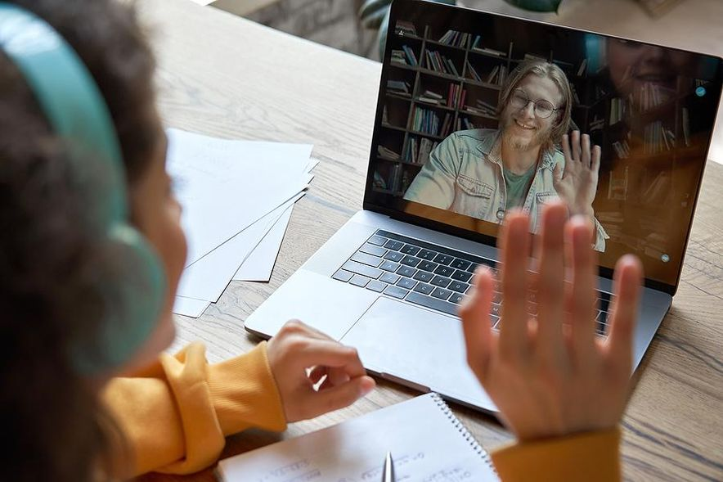
Understand And Admit Your Weaknesses
The only way to develop both personally and professionally as a college student is to first understand what needs to be developed in the first place. Self-reflection is so crucial in all of our lives, but especially during your college years. Taking ownership of what you don't do well and trying to improve is just as important, if not more important, than understanding what you are good at.
College is the time to improve and grow and that will only happen if you have goals set on what skills you want to enhance. If you have never completed a transferable skills survey before, I encourage you to give it a shot, as this can really show you where you need more development.

Slide 13

Research, Read, Be Aware
All of us have had people we've looked up to in our lives. For those of us who have been in the workforce for a good while, we've probably had mentors and leaders that we have looked up to along the way. One way you can take ownership of your own development is to emulate the people you look up to. By being aware of your surroundings and understanding what exactly has drawn you to certain people, you can understand what skills you need to showcase to someday be in that position of leadership. This only happens through reading, researching, and being intentional with your learning.
Having outstanding job specific skills are important, but you need to have the intangible qualities that employers are looking for to ultimately reach your career goals. To grow in your development, you must first identify the skills you actually want to develop.

Slide 14

Get Out Of Your Comfort Zone
As a college student, I knew that I was a terrible public speaker and not very good in large social situations, as I would get extremely nervous. One year, I forced myself out of my comfort zone and attended a career fair at the University.
At this fair, there were over 100 employers and it was an extremely packed room. While I accomplished something just by going, I didn't actually do anything. That's right, I simply walked around and didn't talk to anybody.
Many of us are afraid to stray from what is comfortable to us, but you only get better with practice and experience.
I challenge you to try something new that gets you out of your comfort zone at least once a month. Obviously, the key to that is to actually take action and not just walk around!
By getting out of your comfort zone, you can learn a lot about yourself and develop interests that you never thought were possible.

Slide 15

Diversify Your Experiences
There is no better way to take advantage of your own development than by diversifying your experiences while in University.
Think about it. The more involved you are and the more experiences you have, the better your chances of finding out what your true passion is.

Slide 16

Stop Waiting For Things To Happen...Make Them Happen!
If you want to develop yourself, get the career you want, and meet the people that you want to meet, then go do it! Take charge and make things happen for yourself by being proactive. If you are an employer, what skills does it show you when someone proactively comes to you looking to learn more? Plus, as a student, you are in a learning phase and can play the student card, which will probably get you in the door easier than someone my age. Take control of your own fate and make things happen.
So many things that happen in your career and life are going to be out of your control. Take that control back and take ownership of your own development. Learn from every experience—good or bad. You never know, one day all the failures that you learned from when you were a college student could lead you to the career you never knew you always wanted. Be a lifelong learner and you never know what you could be doing next.

Slide 17
How To Choose The Right Internship?

Slide 18
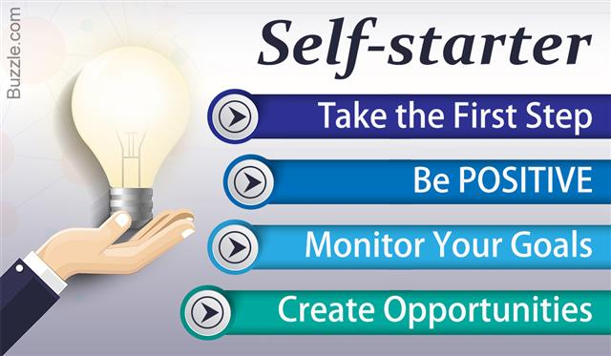
Don't Base The Decision On Money
An unpaid internship can lead to a great return down the road, and, not to mention, a lucrative job offer. Focus your internship selection on companies that are looking to grow and expand, and possibly bring you in after graduation to advance their company to the next level.
Be A Self-Starter
Finding the right internship is very much like a traditional job search. It's important to have an idea about some of things you may want to pursue, then make a bucket list of companies that you are interested in interning at.
Which sector?
What are your qualifications?
What will be your specific responsibilities?
What will you get paid?
Where is it?
What’s the environment like?
Will you get the opportunity to network?
What skills will you learn?

Slide 19
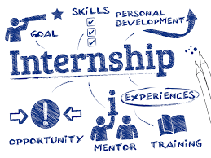
Select An Internship That Will Allow You To Build Essential Skills
There are certain essential skills that matter in the workforce when looking to grow your career. Leadership, collaboration, project management, and relationship building are among some of those intricate skills. When looking into internships, research the types of skills that you will obtain during that internship.

